Slide 1

Quantum Computing with IonQ
Solving Real Business Problems with Trapped-Ion Technology

Slide 2
Quality Over Quantity
IonQ's trapped-ion quantum computers excel where others fail.
Two key advantages:
All-to-All Connectivity
High Gate Fidelity (>99.9%)
What this means:
Complex algorithms competitors can't run
Precision-dependent science that requires accuracy
Fundamental architectural superiority

Slide 3
The Complete Story
Act 1: Physics (Demos 1-3)
Hardware – All-to-all connectivity
Finance – Arithmetic circuits
Chemistry – High-fidelity gates
Act 2: Software (Demos 4-5)
Error Mitigation – 15% → 92% success
Compression – 75% gate reduction
Act 3: Applications (Demos 6-7)
Optimization – K_20+ vs K_7
Materials – 4x deeper simulation
Act 4: Hybrid Future (Demos 8-10)
Error Correction – 5-8x fewer qubits
Quantum AI – 50% less training data
Logistics – $15M annual ROI

Slide 4
Demo 1: The Connectivity Challenge
Some algorithms require every qubit to talk to every other qubit.
Example: Quantum Fourier Transform (QFT)
On grid-based hardware → SWAP gate explosion
On IonQ → Direct interactions, zero overhead

Slide 5
Demo 1: Architecture Comparison
Competitor (Linear Chain):
0—1—2—3—4—5—6—7—8—9—10—11
To talk to distant qubit? Bucket brigade of SWAPs.
IonQ (All-to-All):
Every qubit connected to every other qubit
Direct interaction in a single pulse.

Slide 6
Metric | Competitor | IonQ
Total Gates | ~150+ | ~50
SWAP Gates | 40-60 | 0
Circuit Depth | 8x deeper | Baseline
10-Qubit QFT Results:
Every SWAP gate is wasted energy and noise. IonQ spends zero budget on moving data around, so we spend it all on solving the problem.
Demo 1: The Metrics

Slide 7
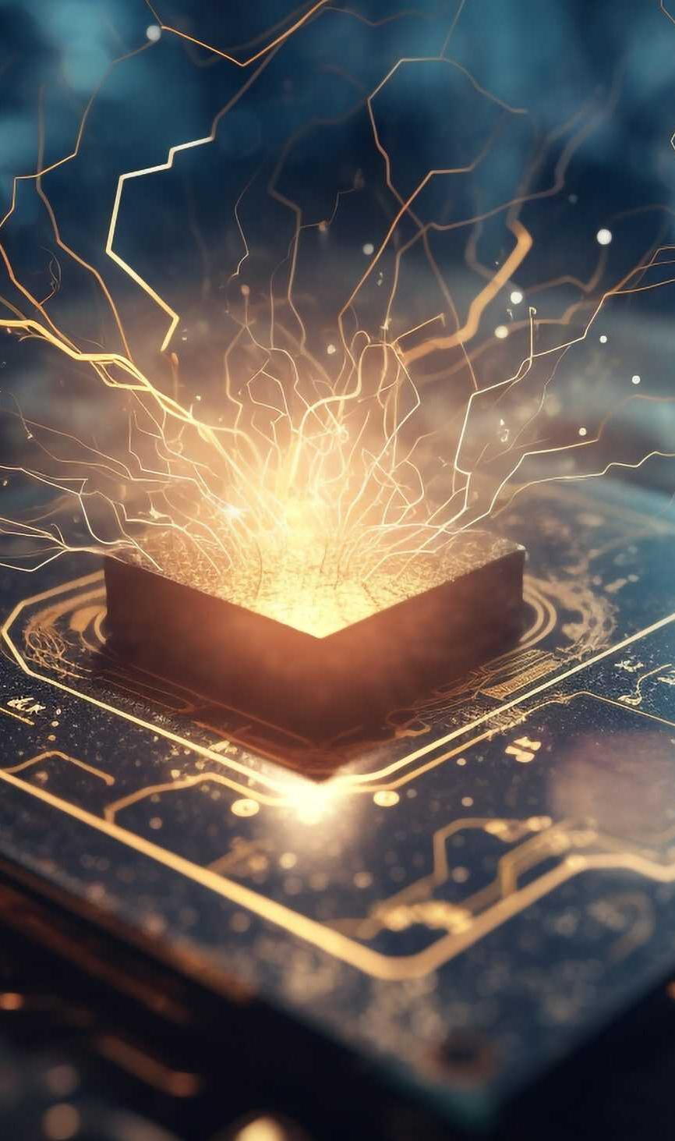
Demo 1: Scalability
10-qubit QFT: 7.5x advantage
20-qubit QFT: 100x+ advantage
As you scale, the advantage compounds exponentially.
Proof:
IonQ's advantage is structural
Some problems are impossible on grid hardware
Same problems are solvable on IonQ

Slide 8

Demo 2: American Option Pricing
The Business Problem:
American options can be exercised at any time.
Why Quantum?
Classical: Backwards induction (slow)
Quantum: Amplitude Estimation
Your value:
Faster, more accurate pricing
Better trading decisions
40-60% shallower circuits on IonQ

Slide 9
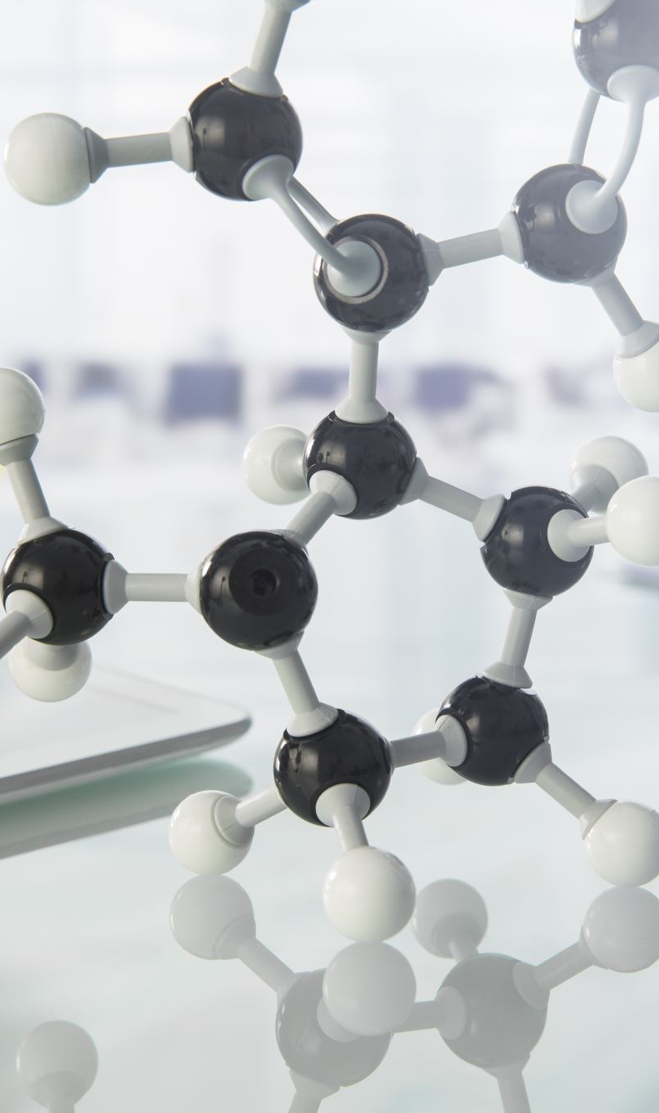
Demo 3: Chemistry Simulation
The Business Problem:
Design new materials (carbon capture) via simulation.
Why IonQ?
Requires extreme fidelity (>99.9%)
VQE is noise-sensitive
Competitors can't maintain accuracy
IonQ Advantage:
Native MS gates = 10x better fidelity
High-fidelity = scientifically usable results

Slide 10
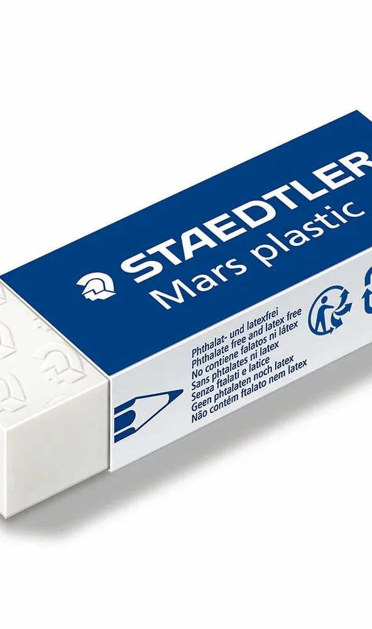
Demo 4: Error Mitigation
The Breakthrough:
From 15% to 92% success rate (software only)
What We Do:
Debiasing: 100+ circuit variants → systematic errors cancel
Sharpening: Majority voting for known answers
Availability: Azure Quantum & Amazon Braket (TODAY)

Slide 11
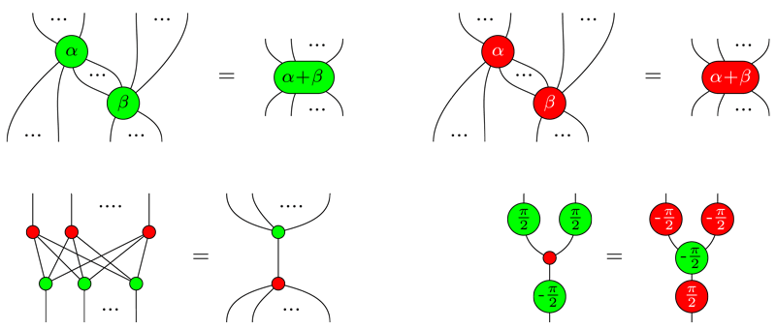
Demo 5: Circuit Compression
ZX Calculus Optimization:
50 CNOT gates → 5 MS gates (90% reduction)
Why It Matters:
Chemistry ansatz: 100 layers → 5 layers
Noise accumulation: Exponential → Minimal
Reliability: Impossible → Production-ready
This Photo by Unknown Author is licensed under CC BY

Slide 12
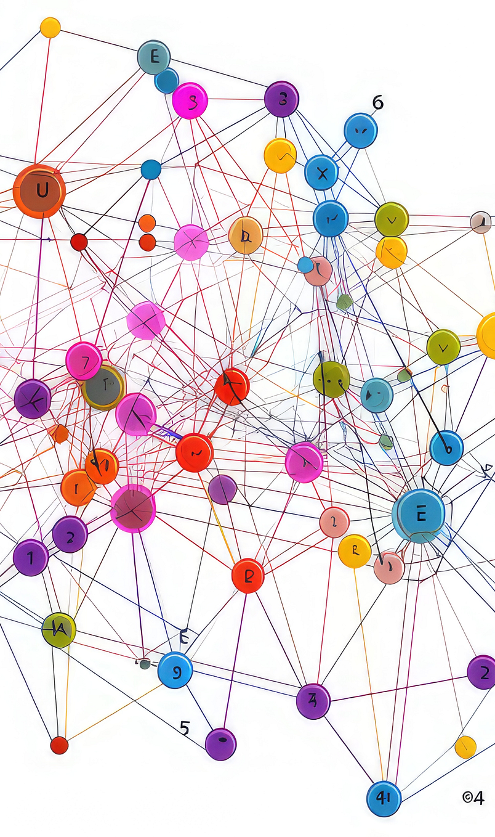
Demo 6: MaxCut on Complete Graphs
The Problem:
Every node connects to every other node.
The Advantage:
Competitors max out at K_7
IonQ handles K_20+ (1000:1 scale difference)
Why?
All-to-all connectivity is native on IonQ, impossible on competitors without SWAP chains.

Slide 13
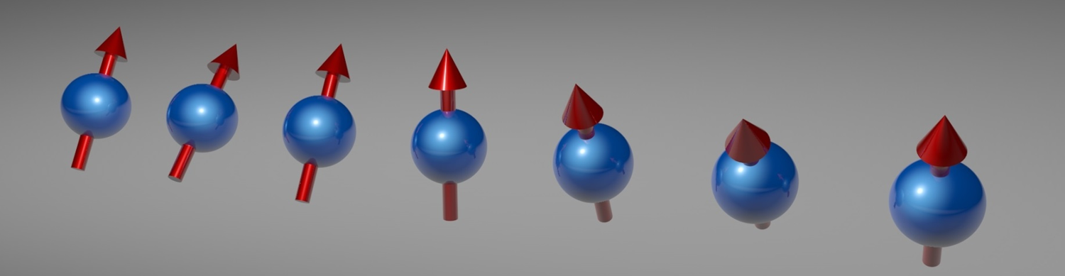
Demo 7: Material Science
Heisenberg Spin Chain Simulation:
Metrics:
Competitors: t=0.5 (60% error)
IonQ: t=2.0 (6% error)
Application: Battery design, phase transitions
Partnership: Hyundai (real-world carbon capture)

Slide 14

Demo 8: Error Correction
Race to Fault Tolerance:
Competitors Must Use:
Surface Code
Cost: 100+ physical qubits per logical
Need 100,000+ qubits for 1000 logical
IonQ Can Use:
LDPC/Bacon-Shor codes
Cost: 13-20 physical per logical
Need 13,000-20,000 qubits for 1000 logical
Advantage: 5-8x fewer qubits

Slide 15
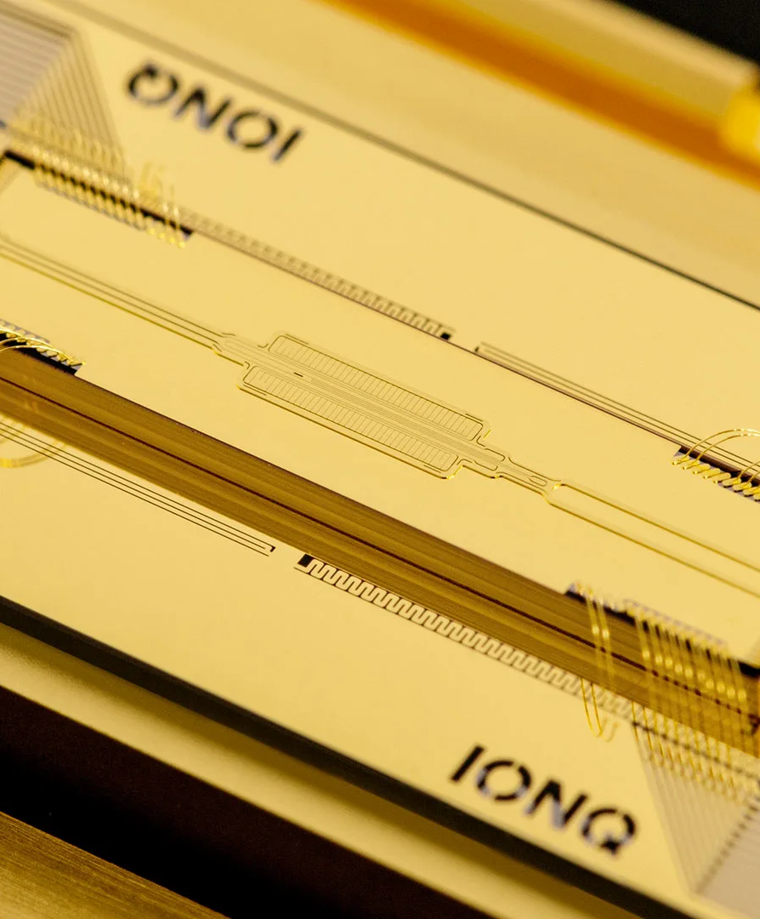
Demo 9: Quantum-Enhanced AI
LLM Fine-Tuning with Quantum Layers:
Quantum layers are MORE expressive
Achieve same accuracy with 50% less data
Cost Impact:
Traditional: $5,000 annotation
Quantum: $1,500 annotation + $100 compute
Savings: $3,400 per model

Slide 16

Demo 10: Power Grid Optimization
Unit Commitment Problem:
26 generators × 24 hours = 2^624 schedules
The IonQ Solution:
Hybrid VQE finds near-optimal in 5-10 minutes
Financial Impact:
Annual operating cost: $500M
IonQ savings: $15M/year (3-5% improvement)
Payback: <1 hour of operations
ROI: 2,000:1
This Photo by Unknown Author is licensed under CC BY

Slide 17
Why This Matters
Some quantum computers can run algorithms reliably.
Others cannot.
This isn't marketing—it's physics.
IonQ wins on:
High connectivity (finance, optimization, AI)
High fidelity (chemistry, materials)
Efficient error correction (path to 1000+ logical qubits)
Hybrid quantum-classical loops

Slide 18
Era 1: NISQ (2024-2025)
Better results from fewer qubits
Era 2: Hybrid (2025-2028)
Immediate revenue impact ($15M/year shown)
Era 3: Fault-Tolerant (2028+)
5-8x fewer physical qubits via efficient codes
Winner: Who bridges all three eras first.
IonQ's architecture ensures we arrive first.
The Three Eras

Slide 19
Demo 1: Hardware - 2.1x shallower
Demo 2: Finance - 1.2x depth, zero SWAPs
Demo 3: Chemistry - 4.5x shallower, 99.9% fidelity
Demo 4: Error Mitigation - 15% → 92% success
Demo 5: Compilation - 75% gate reduction
Demo 6: Optimization - K_20+ vs K_7
Demo 7: Materials - t=2.0 vs t=0.5
Demo 8: Error Correction - 13-20 vs 100+ qubits
Demo 9: Quantum AI - 50% less training data
Demo 10: Logistics - $15M annual ROI
Summary: All 10 Demos

Slide 20
Your Path Forward
1. Understand hardware advantage (Demos 1-3)
2. See software innovation (Demos 4-5)
3. Evaluate your use case (Demos 6-7)
4. Understand long-term vision (Demo 8)
5. Deploy hybrid (Demos 9-10)
6. Run proof-of-concept
7. Scale to production
Access Today: Azure Quantum, Amazon Braket

Slide 21
Questions & Discussion
Let's Talk:
Which demo resonates most?
What problems are you solving?
What would convince your team?
How can IonQ help your roadmap?
Next Steps: Run one of these on your use case.

